Slide 1

Migrating Data using Polybase

Slide 2




Tools of the Trade
Cloud
Someone else owns the hardware
On-Premise
You own the hardware

Slide 3
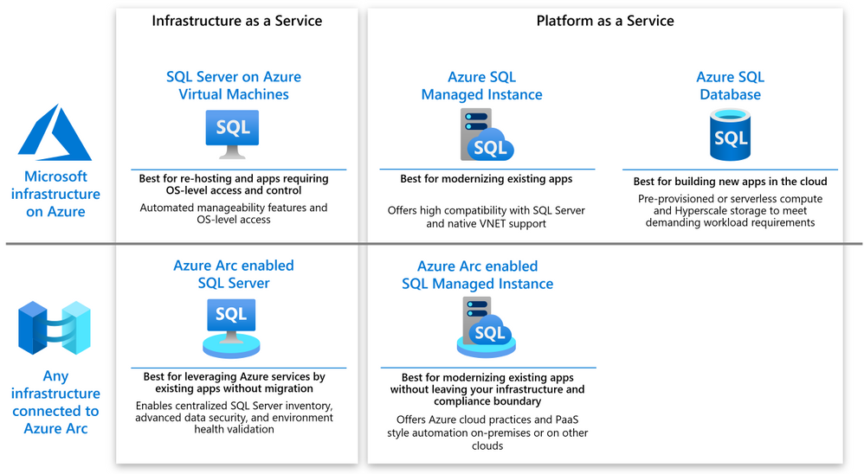
Azure DB offerings
https://tinyurl.com/hk7f6ujx

Slide 4




The Plan
Linked Server?
On-Premises SQL Server
Azure SQL Offerings
Azure BLOB Storage
https://tinyurl.com/hk7f6ujx

Slide 5
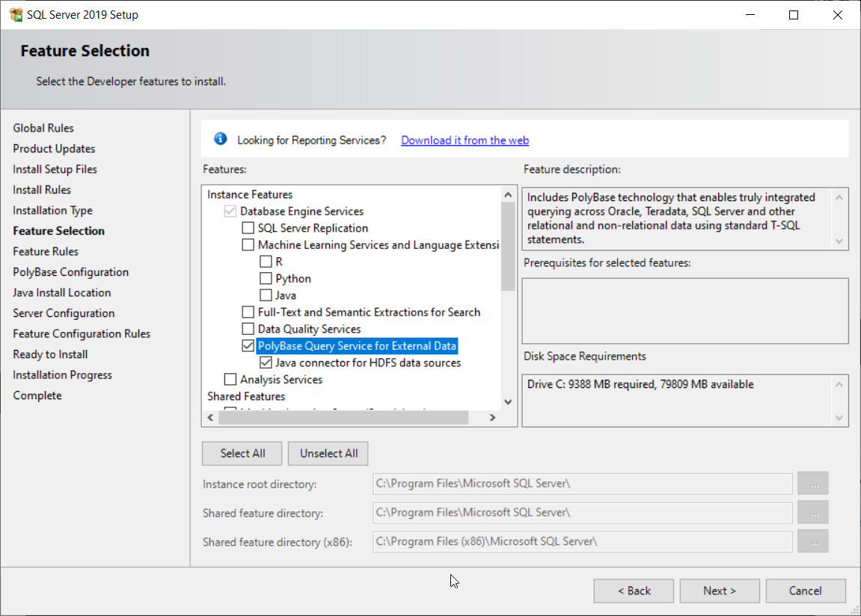
Preparing for Polybase
Installing and Downloading
SQL Server Express
https://tinyurl.com/y6y8csu3
Editions
Standard
Enterprise
Developer
https://tinyurl.com/yzbvuyeb

Slide 6
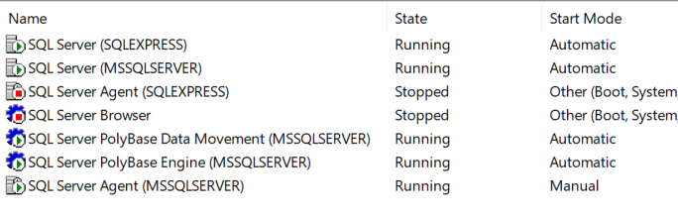
Enabeling Polybase
Possible Issues
TCP/IP Not Enables
Mixed Mode Auth
Java JRE Issue
https://tinyurl.com/yzbvuyeb

Slide 7
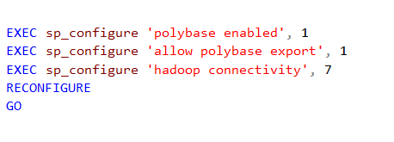
Preparing for Polybase
Make sure that mixed mode Authentication is enabled as well
https://tinyurl.com/a8uc7fd9
https://tinyurl.com/yzbvuyeb

Slide 8
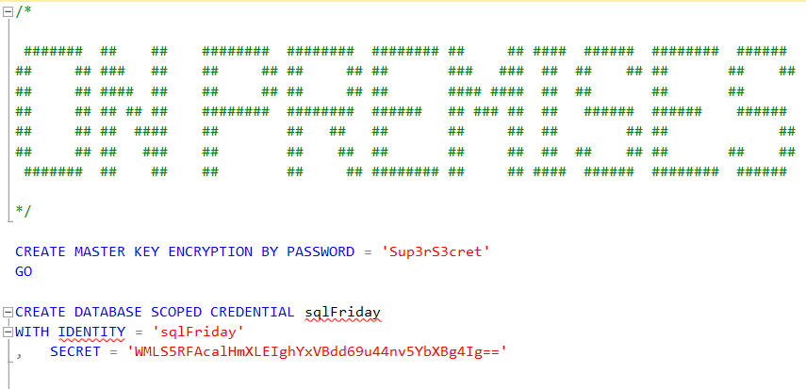
Authentication & Credentials
https://tinyurl.com/yzbvuyeb

Slide 9
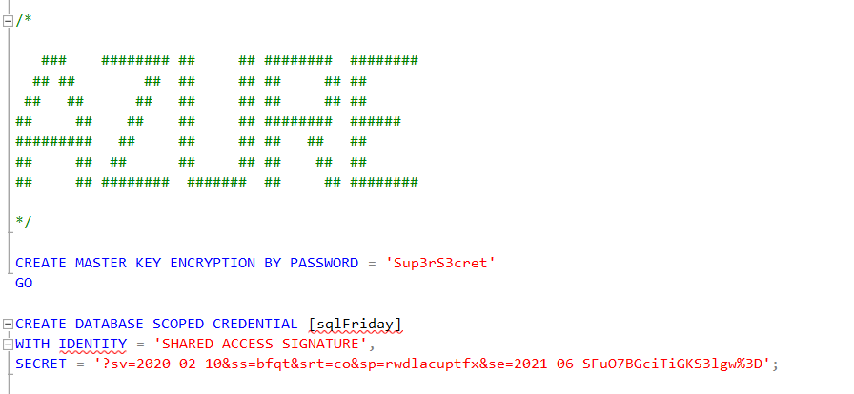
Authentication & Credentials
https://tinyurl.com/yzbvuyeb

Slide 10
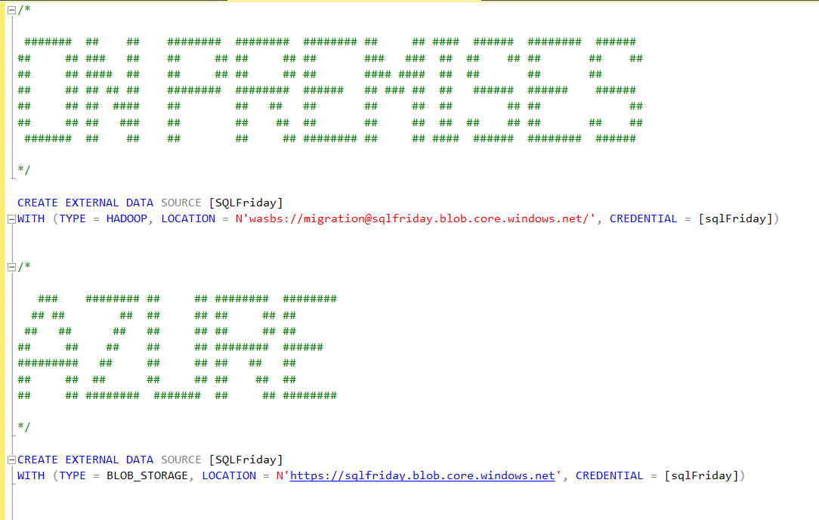
External Data Sources
Disclaimer
For Azure Synapse Dedicated Pools
And managed instance you can use HADOOP instead of BLOB_STORAGE
https://tinyurl.com/58ptfdzz
https://tinyurl.com/58ptfdzz

Slide 11
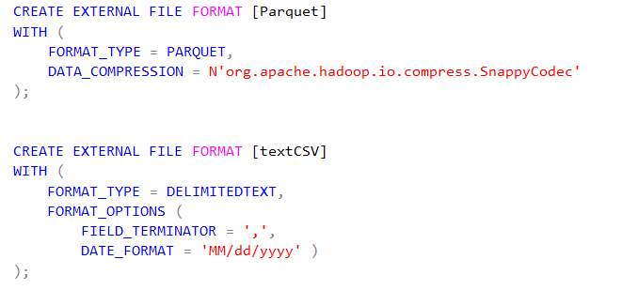
External File Formats
Formats
Delimited
ORC
Parquet
JSON
https://tinyurl.com/56zcddkz
https://tinyurl.com/56zcddkz

Slide 12
The Magic
Linked Server?
On-Premises SQL Server
Azure SQL Offerings
Azure BLOB Storage
https://tinyurl.com/hk7f6ujx

Slide 13
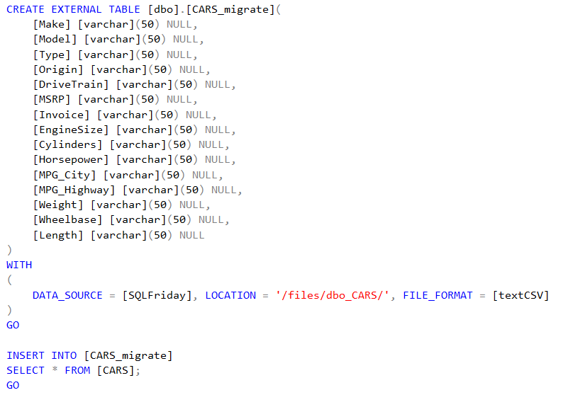
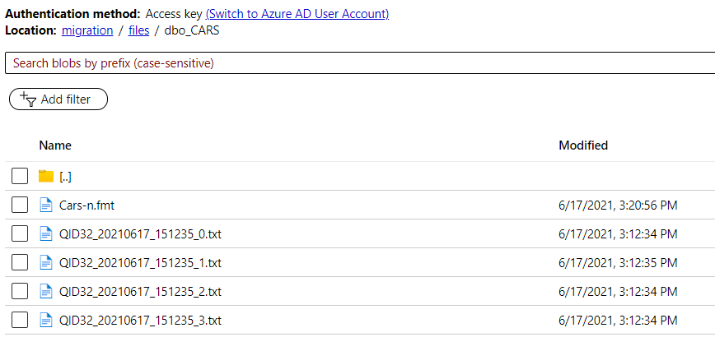
Create External Table
Process
Create External Table (schema)
Insert rows into External Table
https://tinyurl.com/56zcddkz
https://tinyurl.com/56zcddkz

Slide 14
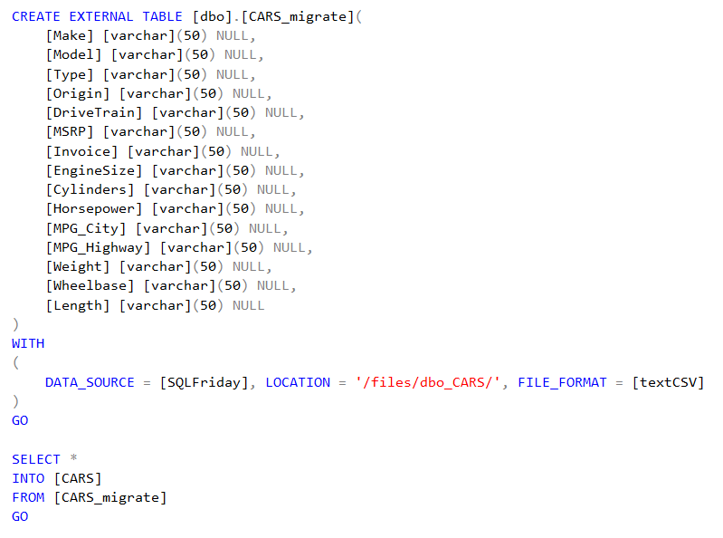
Create External Table
Process
Create External Table (schema)
Insert rows into External Table
https://tinyurl.com/56zcddkz
https://tinyurl.com/56zcddkz

Slide 15
Additional Resources
Github Link to Presentation: https://tinyurl.com/nvfmwfrb
https://tinyurl.com/yjf2h9g6

Slide 16

Questions
https://blog.voogie.online

